Slide 1

Note: The data and information in this document is reflective of a hypothetical situation and client. This document is to be used for KPMG Virtual Internship purposes only.
Sprocket Central Pty Ltd
Data analytics approach
Data Analyst – Harshitha Pasem

Slide 2
Note: The data and information in this document is reflective of a hypothetical situation and client. This document is to be used for KPMG Virtual Internship purposes only.
Agenda
Introduction
Data Exploration
Model Development
Interpretation

Slide 3
Note: The data and information in this document is reflective of a hypothetical situation and client. This document is to be used for KPMG Virtual Internship purposes only.
Introduction
Analyze the existing customer dataset to determine customer trends and behavior to identify the 1000 new customers that should be targeted to drive the most value for Sprocket Central Pty Ltd.
Here are some key reasons why this analysis is important:
Targeted Marketing Campaigns
Customer Retention and Loyalty
Product and Service Improvement
Competitive Advantage

Slide 4
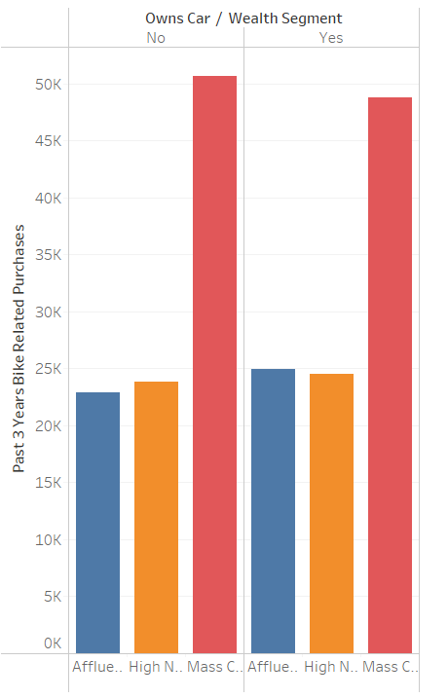
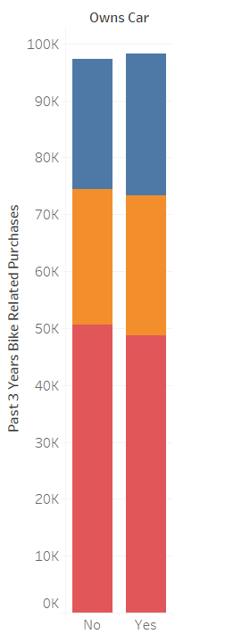
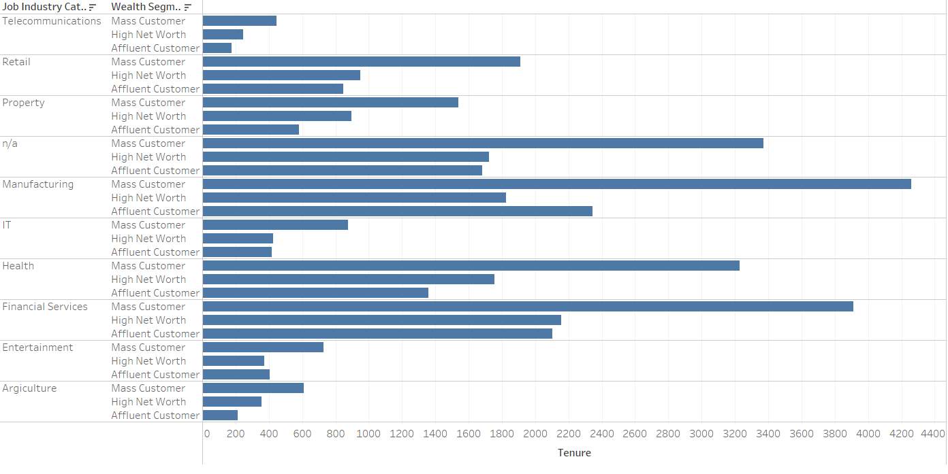
Note: The data and information in this document is reflective of a hypothetical situation and client. This document is to be used for KPMG Virtual Internship purposes only.
Data Exploration
In week 1 we are trying to focus on data exploration.
Here are a few samples from the data exploration.

Slide 5
Note: The data and information in this document is reflective of a hypothetical situation and client. This document is to be used for KPMG Virtual Internship purposes only.
Model Development
In week 2 we are focusing on model development.
RFM Model:
Recency (R), Frequency (F), Monetary Value (M)
The RFM model provides valuable insights into customer behavior and allows businesses to allocate resources effectively, improve customer retention, and optimize marketing efforts. By understanding the recency, frequency, and monetary value of their customers, companies can develop targeted strategies to engage and retain high-value customers while also identifying opportunities for growth and increasing customer lifetime value.

Slide 6
Note: The data and information in this document is reflective of a hypothetical situation and client. This document is to be used for KPMG Virtual Internship purposes only.
Interpretation
In week 3 we are focusing on Interpretation.
Emphasize the importance of continuously monitoring the model's performance and updating it with new data.
Regularly evaluate the accuracy and effectiveness of the model in predicting customer behavior.
Incorporate customer feedback and business insights to refine the model and improve its predictive capabilities.

Slide 7
Note: The data and information in this document is reflective of a hypothetical situation and client. This document is to be used for KPMG Virtual Internship purposes only.
Appendix

